Slide 1
The mechanics of breathing
DR.T.AJAYAN
PROF. & H.O.D.
PRACTICE OF MEDICINE

Slide 2
The three steps of respiration
Pulmonary ventilation- movement of air into and out of lungs
Pulmonary respiration-exchanges of gases between air spaces and blood
Tissue respiration between blood and tissue cells

Slide 3
Inhalation and exhalation
Air pressure inside lungs must drop to draw air into them
Lungs expand
Contractions of diaphragm and external intercostals; diaphragm drops
Thoracic cavity expands, and pleura and lungs are pulled outward

Slide 4
Forced inhalation
Accessory muscles
Sternocleidomastoid (lift sternum)
Scalene (elevate first two ribs)
Pectoralis minor (elevate 3rd through 5th ribs)

Slide 5
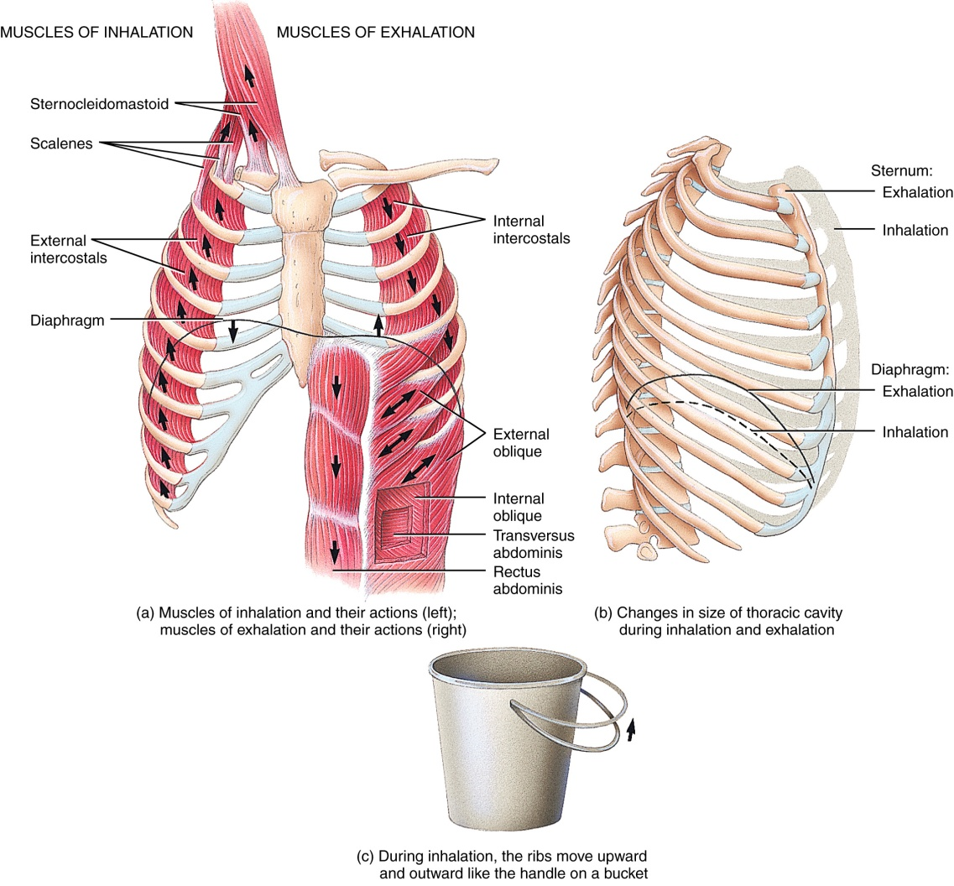
Muscles of breathing

Slide 6
Exhalation
Normal exhalation
Relaxation of external intercostals
Recoil of elastic fibers in diaphrgam and within air passageways
Thoracic cavity becomes smaller
Alveolar pressure exceeds atmospheric pressure
Forced exhalation
Abdominal and internal intercostals

Slide 7
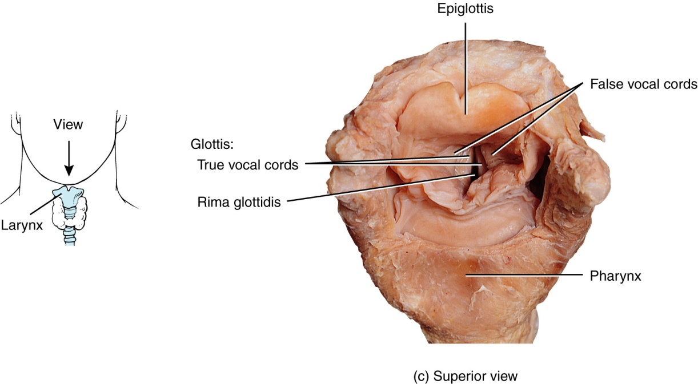
Structures involved in modified respiratory movements

Slide 8
Many modified respiratory movements (p. 753)
Movement | description/stimulus
coughing | Closure, then forced exhalation through rima glottidis. Reflex triggered against larynx, trachea or epiglottis
yawning | Deep inhalation, stimulus unclear
sneezing | Spasmodic contractions of exhalation muscles
hiccupping | Spasmodic contraction of diaphragm, followed by spasmodic closure of rima glottidis. Irritation of nerve endings of GI tract.

Slide 9
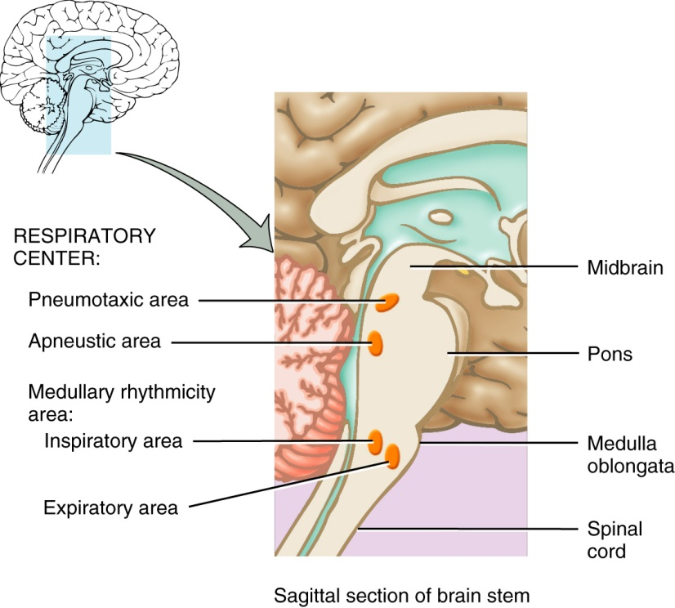
Regulation of breathing
Medullary rhythmicity center
Nerves extend to intercostals and diaphragm
Signals are sent automatically
Expiratory center is activated during forced breathing
Pneumotaxic area
Controls degree of lung inflation; inhibits inspiration
Apneustic area
Promotes inspiration

Slide 10
chemoreceptors
Breathing can be controlled voluntarily, up to a point
Too much CO₂ and H⁺ will stimulate inspiratory area, phrenic and intercostal nerves
Central chemoreceptors: medulla oblongata monitors CSF

Slide 11
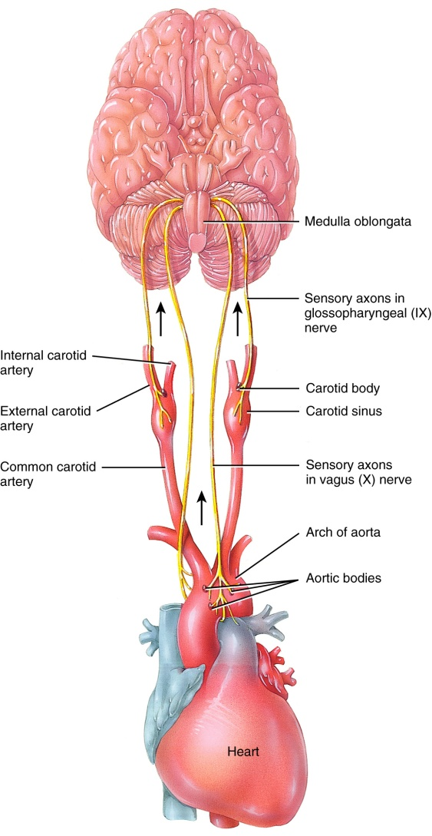
Peripheral chemoreceptors
Aortic bodies
Carotid bodies
Respond to fluctuations in blood CO₂ levels
Baroreceptors prevent overinflation of lungs (promote expiration)

Slide 12
Disorders of the respiratory system
Asthma (chronic inflammation)
COPD (obstruction of airflow, e.g., emphysema)
Lung cancer
Respiratory infections
Cystic fibrosis
ADRS
To name a few

